Slide 1
Financial Analysis Project
Name: Sagar Javari
Course: Business Analysis
Batch: CX-126

Slide 2
Executive Summary
Overview of the project:
Purpose: Evaluate financial decisions using Excel.
Tools: PV, NPV, IRR, XIRR, MIRR, EMI, PMT, etc.
Outcome: Gained insights into investment viability and loan structuring.

Slide 3
Objectives
Understand financial modeling in excel.
Analyze loan repayment and investment returns.
Apply key financial functions to real-world scenarios.

Slide 4
Methodology
Software: Microsoft Excel
Functions Used:
PV, NPV, XNPV
IRR, XIRR, MIRR
PMT, IPMT, PPMT
RATE, NPER

Slide 5
Key Analyses
Annuity Comparison: Beginning vs. end-of-period payments.
Loan EMI Calculation: ₹50,00,000 over 25 years at 11.5%.
Investment Evaluation: NPV and IRR for multiple options.
Cash Flow Timing: Impact on profitability metrics.

Slide 6
Insights & Interpretation
EMI breakdown shows interest-heavy early payments.
IRR and MIRR reveal true investment potential.
NPV sensitive to timing and discount rate.

Slide 7
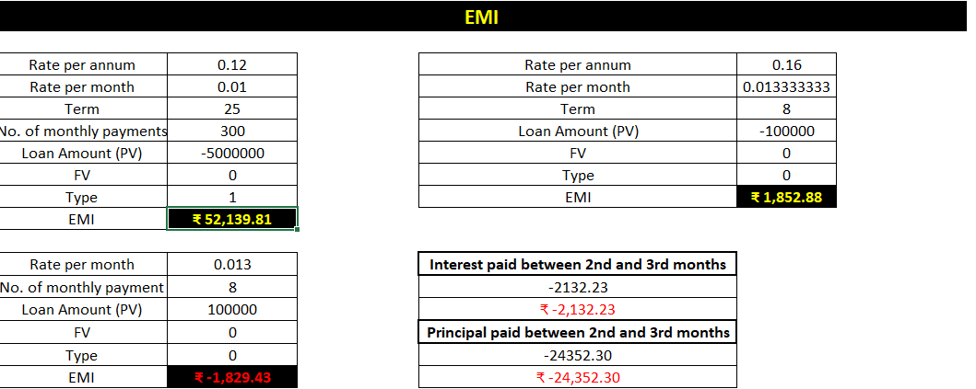
Loan EMI Calculating Using Exel

Slide 8
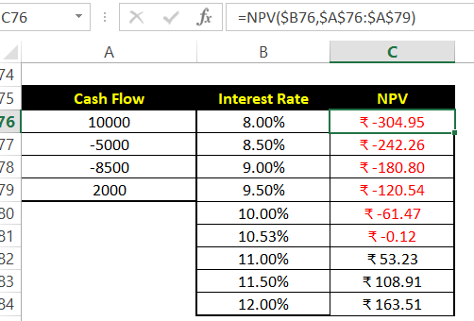
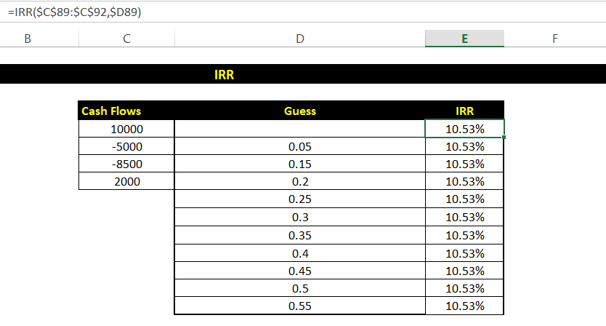
Cash Flow Evaluation Using NPV and IRR Functions in Excel
Formula for NPV(rate, value1, [value2], ...)
Rate: Discount Rate
Value: Cash Flows
Formula for IRR(values, [guess])
Values: Cash Flows
Guess: Initial Guess(optional)

Slide 9
Conclusion
Excel is a powerful tool for financial decision-making.
This project enhanced analytical and technical skills. Real-world relevance in personal and corporate finance.

